Slide 1
Motivation
Module- II
BY-
PREETIBANYA PARIDA

Slide 2
Content to be discussed
Definition & concept
Motive and motivation
Theories of motivation

Slide 3
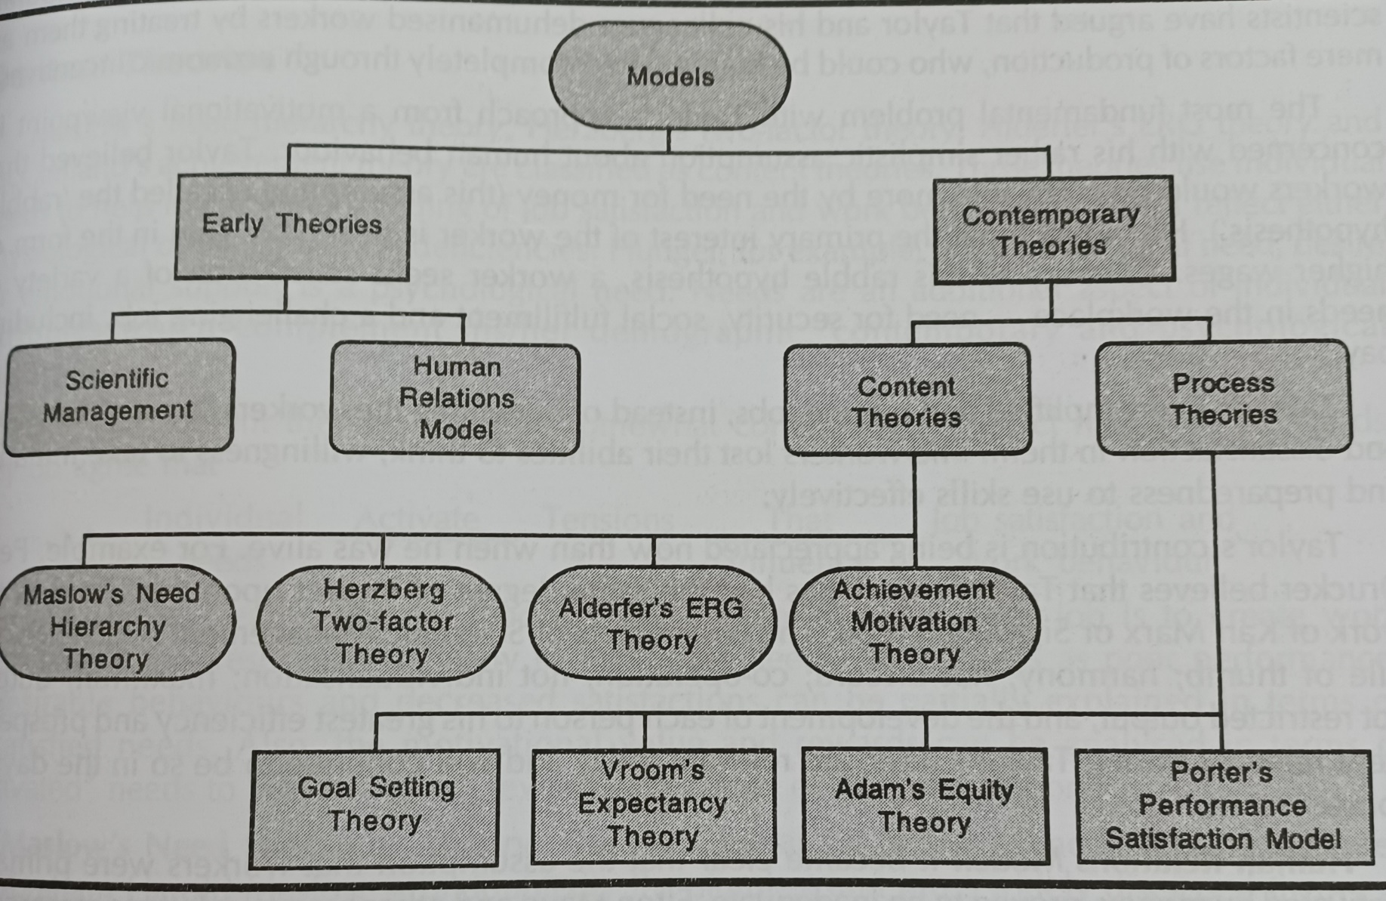
Theories of motivation

Slide 4
Why do some people perform better than others?
Why does the same person act differently at different times?

Slide 5
Motives
Motives are the expressed needs and could be conscious or subconscious.
Sometimes motives define as reason to do something.

Slide 6
Motivating
It is an act of stimulating emotion or desire and promoting it to action.
Research says there are two types of motivation:
1. positive motivation
2. negative motivation (fear/ based on force)

Slide 7
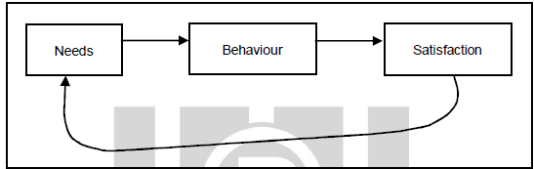
Defining motivation ........
Motivation is one’s willingness to exert efforts towards the accomplishment of his/her goal.
According to Fred Luthans
“Motivation is a process that starts with need that activates behaviour or a drive that is aimed at a goal or incentive”.
Motivation Model

Slide 8
The practical application of Motivation model
BEHAVIOUR
REWARD
SATISFACTION

Slide 9
The content theories
The content theories basically “what” of motivation.
It means focus on the different things that people may feel they need in their lives.
In this content theories people’s motivations will be based on acquiring the things that they think they need.
So, manager first try to understand what employee need.
Because performance of an employee always depends on ability backed by motivation.
Performance = (ability * motivation)

Slide 10
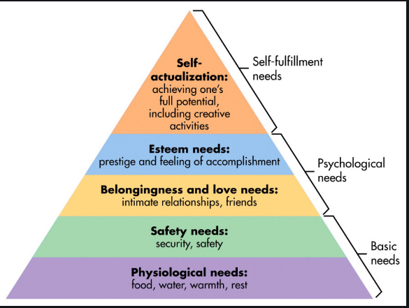
Maslow’s Hierarchy of Needs Theory (Abraham Maslow)
Maslow’s conception of people satisfying their needs in a specified order, from bottom to top.

Slide 11
Discussion on Five Needs
Physiological Needs: (1st order)
1. The Physiological needs are the basic needs for sustaining the human life.
2. These needs include food, clothing, shelter, rest, water, air, sleep.
3. lowest level in the hierarchy of needs.
The management attempts to meet such physiological needs through payment of fair wages.

Slide 12
Security/Safety Needs: (2nd order)
These are the needs connected with psychological fear of loss of job, or hazard.
An employee needs protection from such types of fear.
The safety needs come after meeting the physiological needs.
Such physiological needs lose their motivational potential when they are satisfied.
As a result, safety needs replaces them.
The management attempts to meet such safety needs through security of job , pension at old age, insurance coverage.

Slide 13
Social Needs/Love Belonging (3rd order)
An employee is a human being who desires or likes to stay (belong) in group.
This is treated as basic social need of an individual.
Management provides break time more to satisfy this need.

Slide 14
Self -esteem needs
need to be respected and appreciated by others.
need to have the power and finally prestigious position.
Esteem needs are two-fold in nature.
self-confidence, self-respect, competence
status, reputation, recognition and appreciation by others.
Esteem needs do not assume the motivational properties unless the previous needs are satisfied.

Slide 15
Self-actualisation Needs
Highest among the needs in the hierarchy of needs.
Humans want to utilize their potentials to the maximum extent and desires to become what they are capable of becoming.
It is the ‘growth’ need.
Though every one is capable of self-actualisation, many do not reach this stage.

Slide 16
Herzberg’s Motivation
Frederick Herzberg designed the theory in the year of 1959.
It is also known as Herzberg motivation theory or two –factors theory.
Frederick argued that there are 2 factors that an organization can adjust to influence motivation in the workplace.
1. Motivators : which can encourage employees to work harder.
2. Hygiene factors: These won’t encourage employee to work harder but they will cause them to become unmotivated if they are not present.

Slide 17
Two –factors theory
Job Dissatisfaction
Job satisfaction
Influenced by Hygiene Factors
Pay
Company policies
Fringe benefit
Working condition
Interpersonal relation
Supervisor quality
Improving motivating factors that increase job satisfaction
Influenced by Motivator factors
Recognition
Sense of achievement
Growth and promotional opportunities
Responsibilities
Meaningful work
Improving hygiene factors that decrease job dissatisfaction

Slide 18
Criticism of two-factor theory
Herzberg assumed a correlation between satisfaction and productivity. But the research conducted by Herzberg stressed upon satisfaction and ignored productivity.
when you try to find out the sources of satisfaction and dissatisfaction at work, employees start blame dissatisfaction on factors such as salary structure, company policies and peer relationship and give credit to themselves for the satisfaction factor at work.

Slide 19
Comparison between Maslow theory with Herzberg's theory
Maslow referred to the needs or motives, whereas Herzberg dealt with the goals that tends to satisfy the need.
Hygiene or maintenance factors of Herzberg are satisfied by the Physiological, safety and belongingness needs of Maslow.
Motivator factors of Herzberg tend to be satisfied by the self-esteem and self-actualization needs of Maslow.

Slide 20
Process Theory of Motivation
In content theories of motivation emphasized the inner needs in motivation
The process theories of motivation do not explain how needs emerge. Rather it explain the process through which needs are translated into behaviour.

Slide 21
Vroom’s Expectancy Theory
Expectancy Theory of Motivation was suggested by Victor H. Vroom.
It is based on the idea that work effort is directed towards behaviour that people believe will lead to desired outcomes.
In short we can understood that :
People get motivated by how much they want something and how surely they know that they will get that thing.

Slide 22
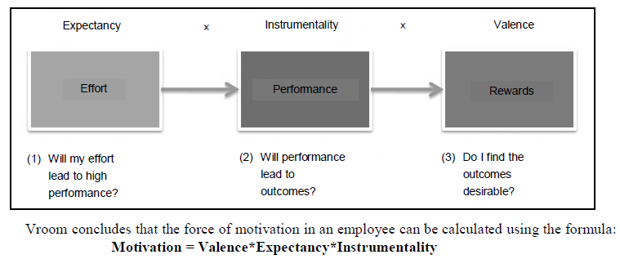

Slide 23
Vroom’s Expectancy Theory
Case 1:
You can never be motivated by unrealistic whishes like you will marry Brad Pitt.
Do you remotely find any possibility of such wish getting fulfilled ??

Slide 24
Vroom’s Expectancy Theory
Case 2:
You strongly want to get a higher range luxury car and you know that this wish is likely to be fulfilled or at least this is a realistic wish that can be fulfilled.

Slide 25
Question to you
Why in case 2 motivation occurs?
The answer lies in three concept of Vroom’s expectancy theory.
1. Expectancy
2. Instrumentality
3. Valence
Let us understand each concept separately.
Then we will put them together to understand how it motivates an individual.

Slide 26
Discussion on three components
Expectancy: Expectancy can be described as the belief that higher or increased effort will yield better performance
It can be restated as follows: Effort – to- Performance (E P)
Instrumentality: It is the relationship between the performance to outcome. Further it can be described that if an individual perform well, then there will be outcome. (P O)
Valence: Valence means “value”. It refers to beliefs about outcome desirability.

Slide 27
Let’s go through a small theory
Marry joins a Company. As soon as she joins her boss tells her that if she completes a given project properly, he will promote her and increase her salary.
Marry becomes happy and she is in hope of increasing her performance does a lot of hard work, overtime etc.
Further with increased performance she hopes to bag all the rewards promised by the Boss.
when she gets the rewards, she hopes to get something to which she assigns a lot of value.

Slide 28
Summary of the story
First hope of Marry is expectancy. This hope is further strengthened if Marry gets sufficient resources and has enough skills at her hand.
Second hope that with good performance she will achieve rewards is called instrumentality.
The third concept is valence. Suppose Marry achieves a decent level of performance, completes the project and impresses to the Boss. The boss in return will bestow reward upon her. Now Marry wanted a fat paycheck but boss gave her a dry promotion. Marry definitely doesn’t assign value to a dry promotion.

Slide 29
So next time when she gets any project, she will work on it half heartedly as the reward she got did not fulfill her personal goal. Here she is demotivated.
But if marry gets a fat check along with promotion, she will be highly motivated. This is valence. She will perform repeatedly to achieve her desire outcome.

Slide 30
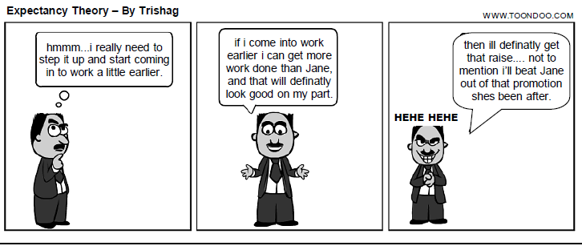
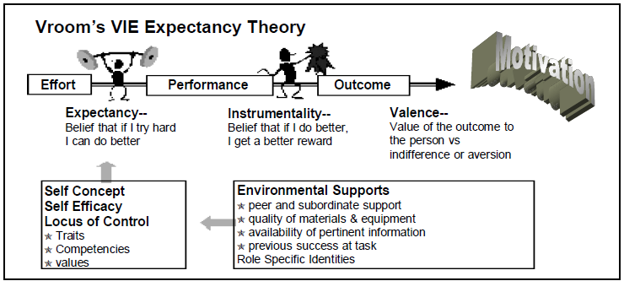

Slide 31
Apply your knowledge (match the column and name the authors )
A | B
1. People are motivated by economic rewards and will get motivated if economic incentives are offered. | a. Two factor theory
2. Needs motivates people. Needs are several and can be categorized in to 5. Hierarchy can be built among them. | b. Expectancy theory
3. Needs motivate employees. They are two dimensions. | c. Need hierarchy theory
4. Work effort is directed towards Behvaiour that people believe will lead to desired outcome. | d. Scientific management

Slide 32
Porter & Lawler theory (based on 4 assumptions)
According to Porter & Lawler , 1st assumption the behaviour of an individual depends on some factors of his own and some factors related to environment.
2nd assumption was that human begins are rational beings and therefore they make conscious decisions about their behaviour in the organization.
3rd assumption is that human beings differ from one another in terms of needs, desires and goals.
4th assumption is that human begins select the most favorable behaviour that helps them get the most desirable outcome.

Slide 33
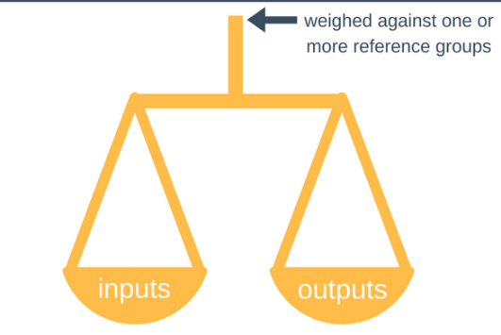
The Process and Contemporary Theories (The equity theory)
The Adam’s Equity theory

Slide 34
Equity Theory
Equity theory is also called as “Social comparison” theory.
Assumptions:
Individuals are motivated by their desire to be equitably treated in their work relationships.
Four important terms in this theory:
1. person
2. comparison other
3.inputs
4.outcomes

Slide 35
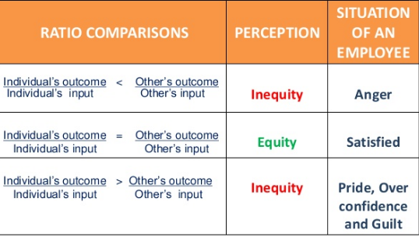
Structure of equity in the workplace is based on the ratio of input / output

Slide 36
Now it’s time to reduce demotivation
Altering his or her inputs
Altering his or her outcomes
Leaving the field

Slide 37
Equity theory at work
Why people are so strongly affected by the situations of colleagues, friends, partners etc., in establishing their own personal equity in their work situations?
People demotivated, if they learn that a colleague (is enjoying a better reward-to-effort ratio.
Manager allocates rewards
Individual makes equity comparisons
Job satisfaction and performance are affected

Slide 38
Conclusion
Adams’ equity theory of motivation says that to be motivated, individuals need to perceive that the rewards they receive for their contributions are fair, and these rewards are similar to those received by their peers. If individuals perceive that their rewards are not fair, they will feel distressed and try to change things to create a sense of fairness.

Slide 39
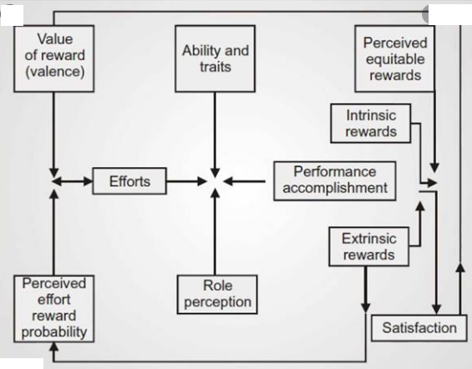
Porter & Lawler theory

